Slide 1
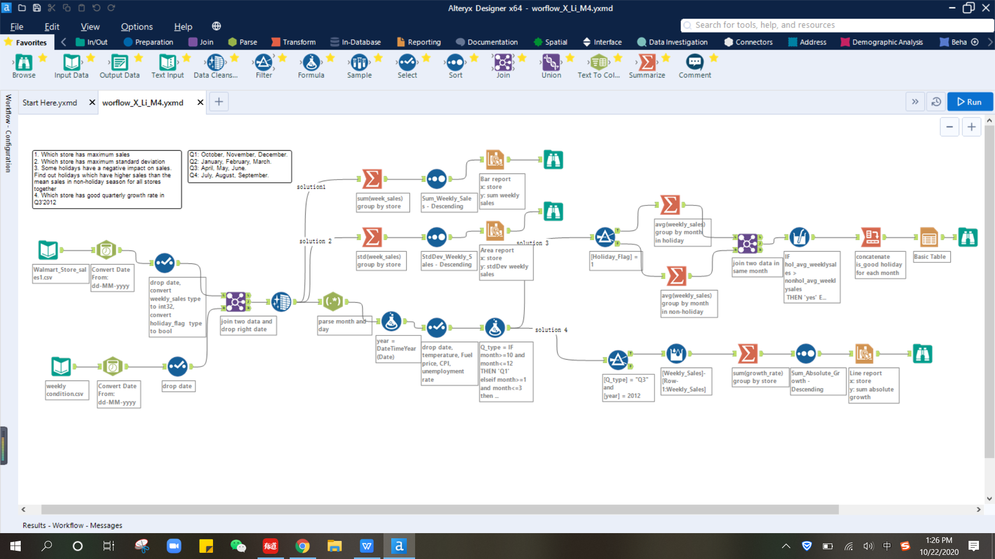
Selling In Alteryx
xiaolan li
Notes:
© Copyright Showeet.com

Slide 2
AGENDA
01
Value of Auto ML
02
What's Alteryx
03
Why Alteryx
04
Compare to other tools
05
Examples
Notes:
© Copyright Showeet.com

Slide 3
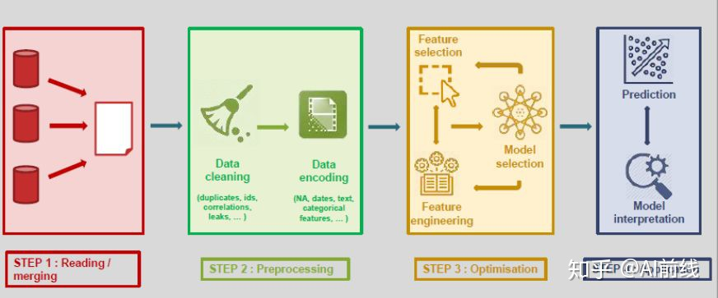
Value of Auto ML
The process of applying machine learning to the end-to-end process automation of real-world problems. AutoML makes true machine learning possible, even for people without expertise in the field.
Every step, from reading data to preprocessing, optimizing, and then predicting results, is controlled and executed by humans. AutoML focuses on two main areas: data collection/forecasting. All the other steps that occur in the middle can be easily automated, while providing a model that is optimized and ready for prediction.

Slide 4
Value of Auto ML
The advantages of AutoML can be summarized into three main points:
- Improve productivity by automating repetitive tasks. This allows data scientists to focus more on problems than models.
- Automating ML pipes also helps avoid errors that might be introduced manually.
- Finally, AutoML is a step toward the democratization of machine learning by making ML capabilities available to all.

Slide 5

Value of Auto ML
Amazon personalization.
We use machine learning/deep learning to provide our customers with product Suggestions and Suggestions for product recommendations.
For many years, we only used algorithms based on basic statistics, but we found that machine learning models were easier to do in this case.

Slide 6
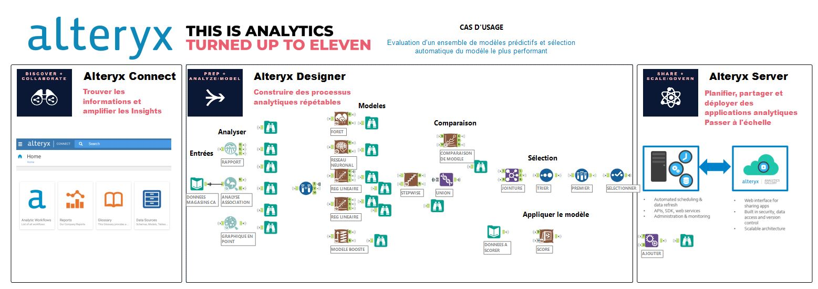
What's Alteryx
A leader in Analytic Process Automation (APA)
Alteryx combines data analytics, data science and business automation into a single platform that allows anyone who needs to use data to solve problems in one place.
The characteristic of Alteryx is that it minimizes the need to write code in a flowchart-like form, allowing people without any programming background to analyze large amounts of data.

Slide 7
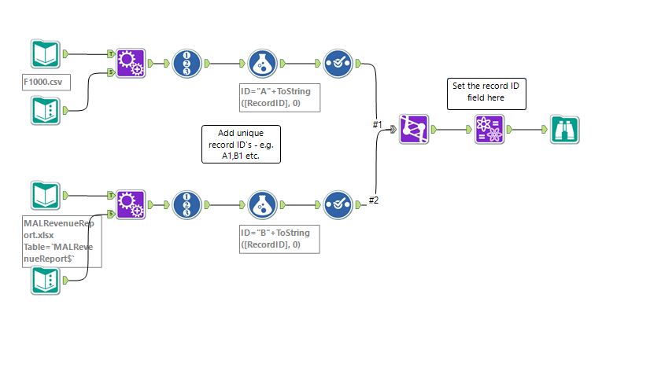
What's Alteryx
Alteryx is a drag and drop software used for data cleansing, data mining, ETL, spatial analysis, machine learning, and other BI-related activities. Its usage can range from relatively basic activities like joining different data sources and pre-processing (which I will show you in a minute), or complicated activities such as predictive modeling, time series, and simulations.

Slide 8
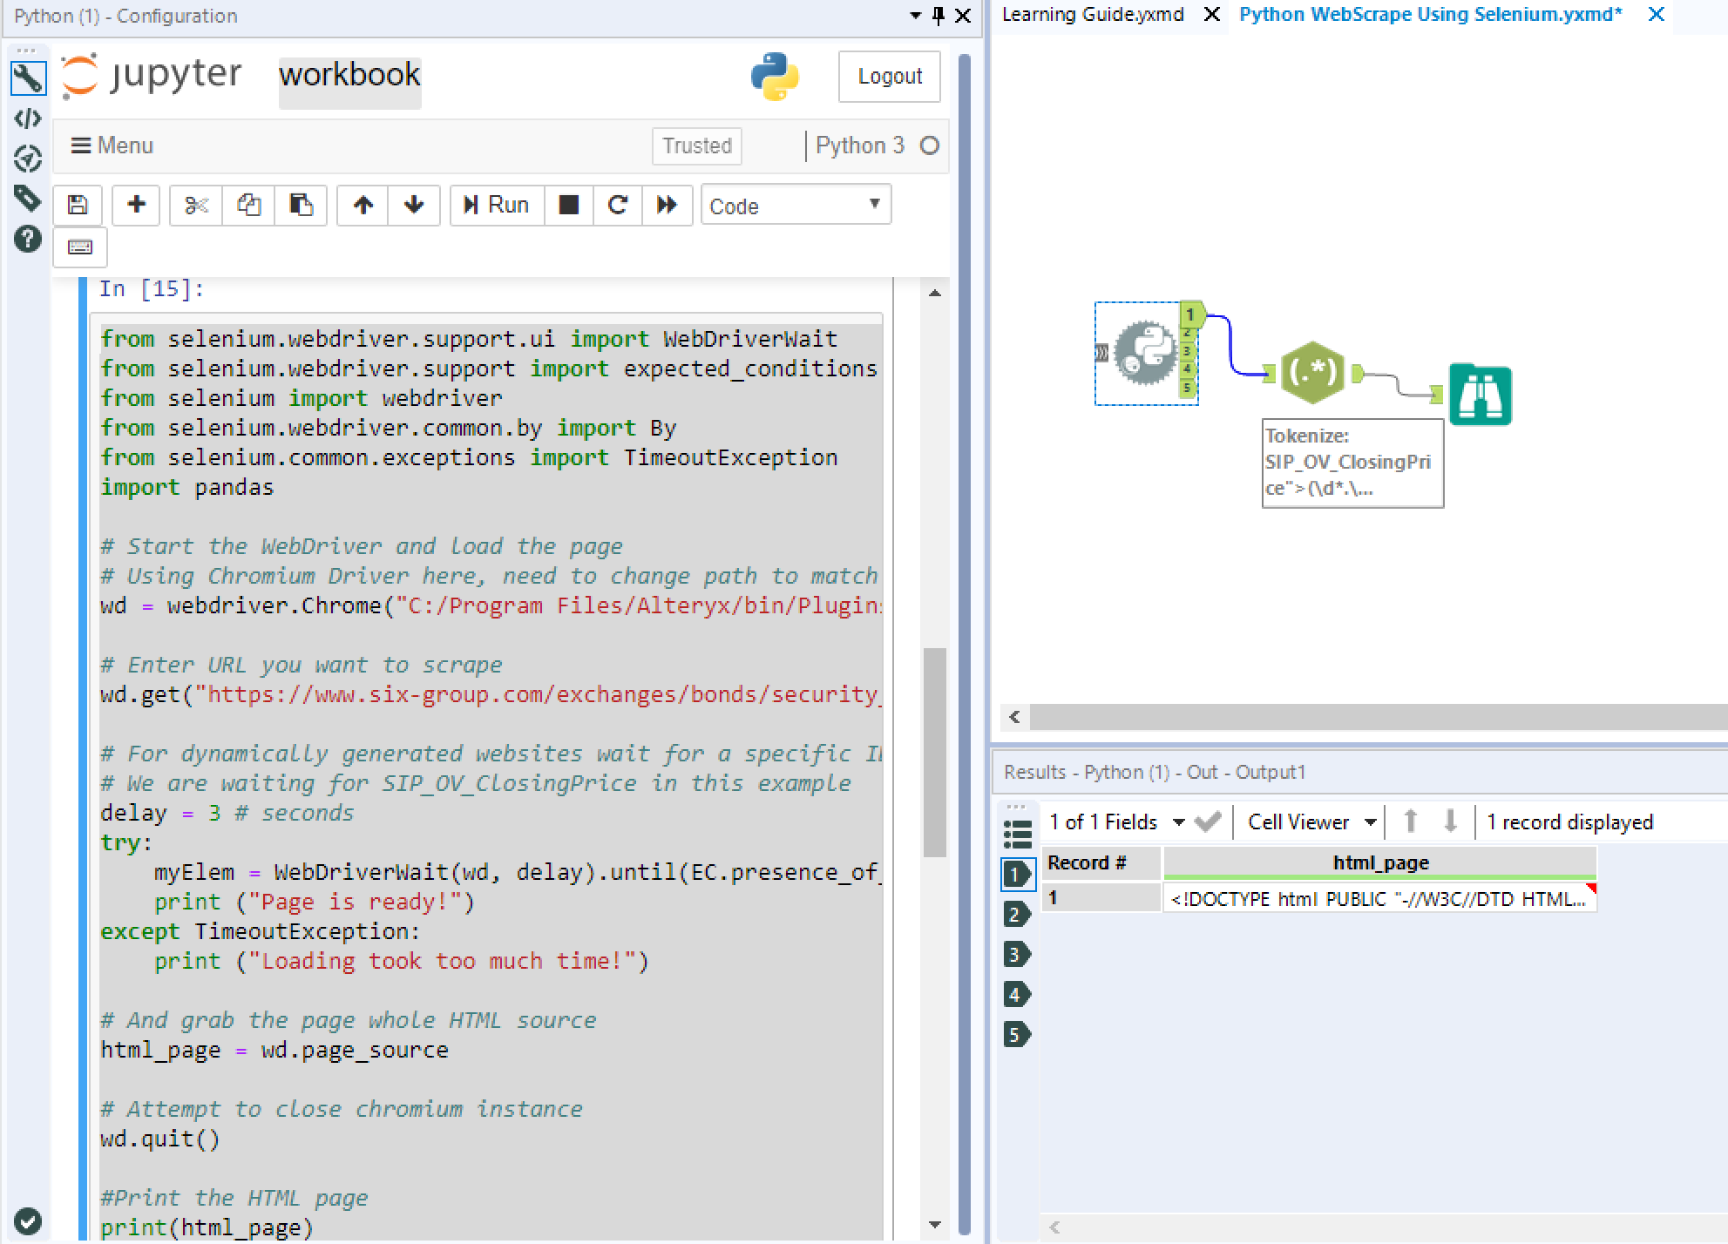
What's Alteryx
Alteryx integrates almost all data analysis processes, including data import, data preprocessing/cleaning, modeling, drawing, and even automatic dashboard/ report generation and output. Skilled use of Alteryx can indeed achieve completely non-programming analysis data.
Alteryx was also integrated with Python, users can also edit Python code themselves in Alteryx with an extended tool

Slide 9
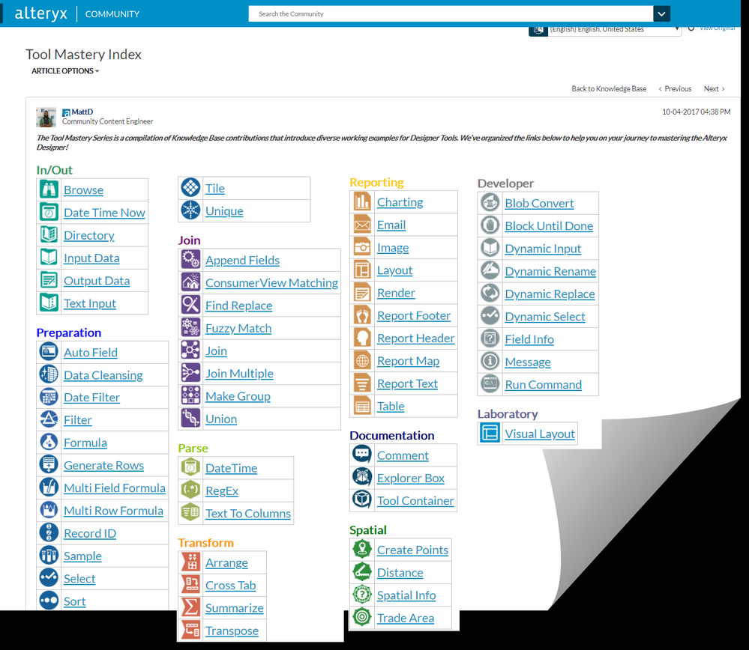
Why Alteryx
Various modeling options available for data preparation. Data clean up, sorting, linking multiple excel files, joining data.
It has built-in functions for merging datasets. Predictive analysis - forecasting with different models as ESM / Arima etc.
It can generate reports, schedule reports, and do auto email reports.

Slide 10
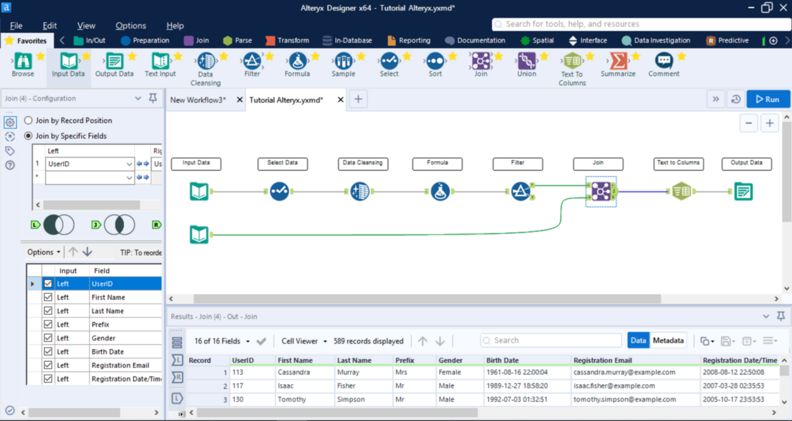
Why Alteryx
1. Input Data:
2. Select Data
3. Data Cleansing
4. Formula
5. Filter
6. Join
7. Text to Column
8. Output

Slide 11
Compare to other tools
Alteryx is a good hybrid choice between using Excel and using SQL/Python/R. I can imagine it being the “Goldilocks zone” for many analysts.
- Excel is limiting for many reasons (lack of centralized storage, lack of collaboration ability, lack of sophisticated audit trail, capacity limitations, functionality limitations, etc). Excel is relatively easy to learn and an all around useful skill in life, but it lacks many crucial attributes for true data analysis.
- SQL combined with Python/R can do almost anything from a data analysis/data science perspective if you know how to use them. The problem here is it takes many years of training to become truly proficient. Many people don’t have the time/effort to devote to this. Even if some analysts did learn these tools, most of them probably wouldn’t utilize the capacity of what they learned in their current roles.

Slide 12
Compare to other tools
Alteryx has practically no limit on record size. If the idea pops in your mind “I can just do this in Excel..” while learning Alteryx, this is not true for many reasons, capacity being one of them. According to the Alteryx “General Discussion” blog, you can apparently manipulate 1 trillion rows no problem.
Geospatial intelligence is arguably its best feature. Going back to Alteryx’s history, it has spent many decades fine-tuning it’s niche as a geographic business intelligence IT company. Although now it may not brand itself on this, its spatial data tools are among the best in the industry. It’s not an official geographic information system (GIS) software, but it is probably the closest thing to being one while still being a generalized analysis tool.

Slide 13
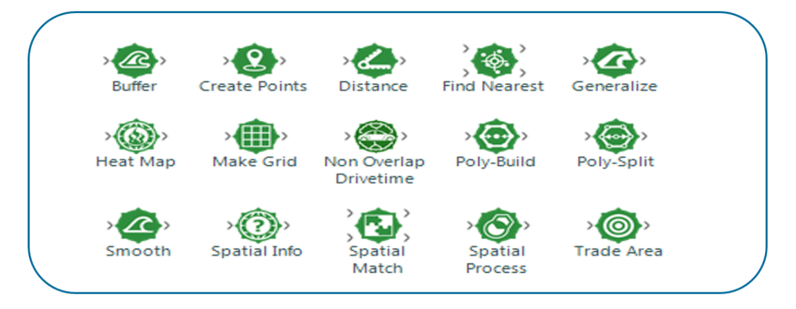
Examples
Spatial (Analytics)

Slide 14
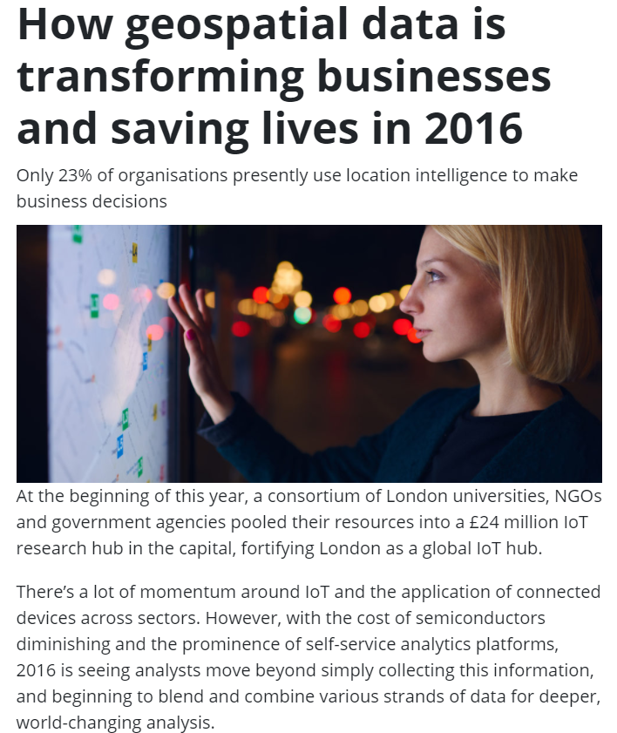
Examples
What can I do with the Spatial Tools?
From a very high level, you can take any data with geospatial content (e.g. a store location or a customer location) and begin to use this to enhance your analysis.

Slide 15
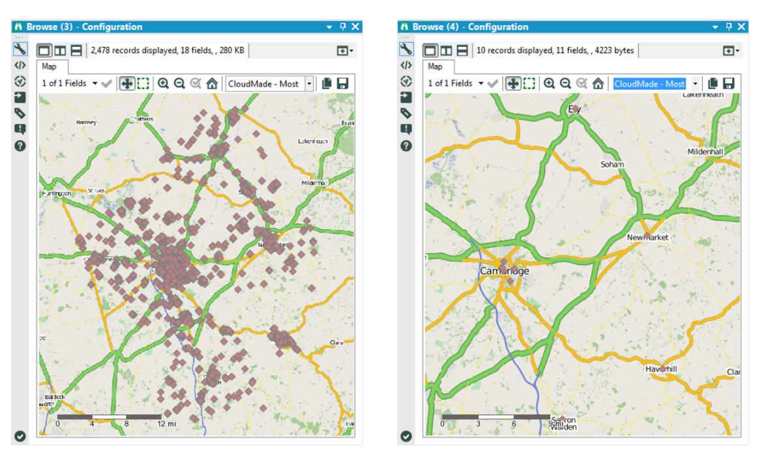
Examples

Slide 16
Conclution
With no programming infrastructure and a high price tag, Alteryx is used more in traditional industries than in the Internet industry.
Major American Banks (jpmorgan Chase, Citigroup, etc.) and automobile companies (Toyota, Ford, etc.) are customers of Alteryx.

